Slide 1
AngularJS + Asp.Net Web Api, Signalr, EF6, Redis + Elasticsearch：前後端整合篇
開發技巧實戰系列(6/6) - Web 前後端整合
講師: 郭二文 (erhwenkuo@gmail.com)
Notes:
開發技巧實戰
1. AngularJS入門篇
2. AngularJS + HighChart：完美網頁圖表整合篇
3. AngularJS + Asp.Net WebApi 2 +SignalR：前後端整合篇
4. AngularJS + Asp.Net WebApi 2+ SignalR + Entity Framework 6 (ORM)：前後端整合篇
5. AngularJS + Asp.Net WebApi 2+ SignalR +Entity Framework 6 (ORM) + Redis (Nosql)：前後端整合篇
6. AngularJS + Asp.Net WebApi 2+ SignalR +Entity Framework 6 (ORM) + Redis (Nosql) + Elasticsearch (全文檢索)：前後端整合篇

Slide 2
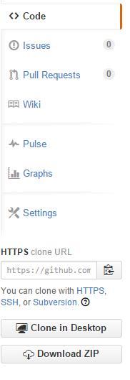
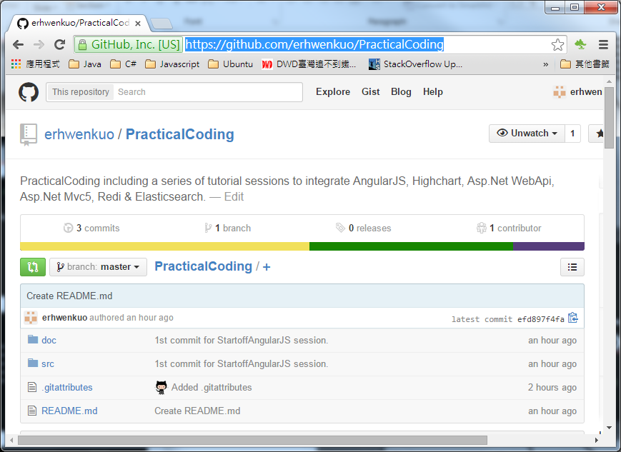

Document, Source code & Training Video (6/6)
https://github.com/erhwenkuo/PracticalCoding

Slide 3


Previous Training Session Document, Source code & Training Video (5/6)
https://www.youtube.com/watch?v=AjEG65JTKKU
http://www.slideshare.net/erhwenkuo/04-integrate-entityframework
Notes:
本章節的內容會延續前一個Session的知識與內容, 如果對前一章節不熟悉的話, 可以在Yoube或Slideshare找到文件與教學錄影

Slide 4
Agenda
Elasticsearch Introduction
Elasticsearch Workshop
Elasticsearch in action using Stackoverflow Datadump
Developing Angularjs with Elasticsearch
Highchart , AngularJS ,Web API2 , SignalR2 , EF6 , Redis + Elasticsearch Integration

Slide 5

Elasticsearch Introduction

Slide 6
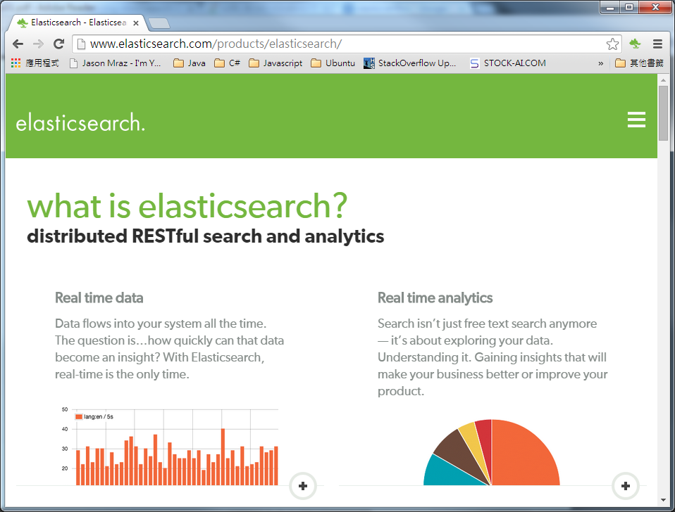
Elasticsearch Website
Http://www.elasticsearch.com/

Slide 7
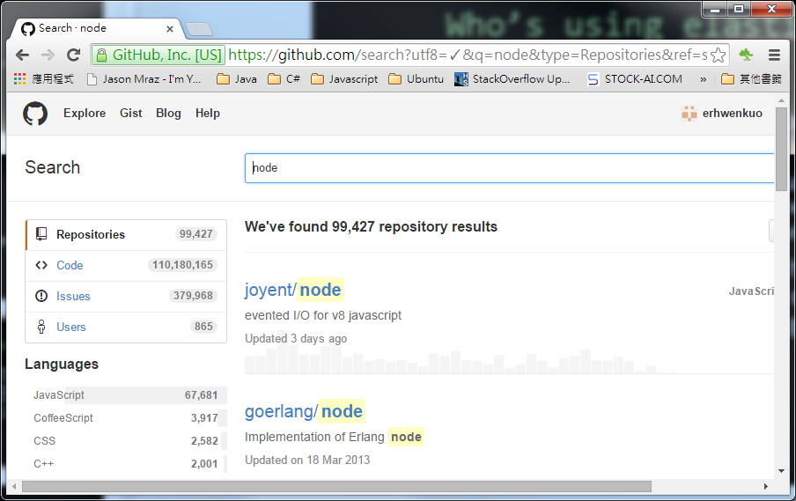
Who’s using elasticsearch?
GitHub
GitHub uses Elasticsearch’s robust sharding and advanced queries to serve up search across data in 4 million users’ code repositories.
GitHub uses Elasticsearch’s routing parameter and flexible sharding schemes to perform searches within a single repository on a single shard, doubling the speed at which results are served.
GitHub uses Elasticsearch’s histogram facet queries, as well as other Elasticsearch analytic queries, to monitor their internal infrastructure for abuse, bugs and more.

Slide 8


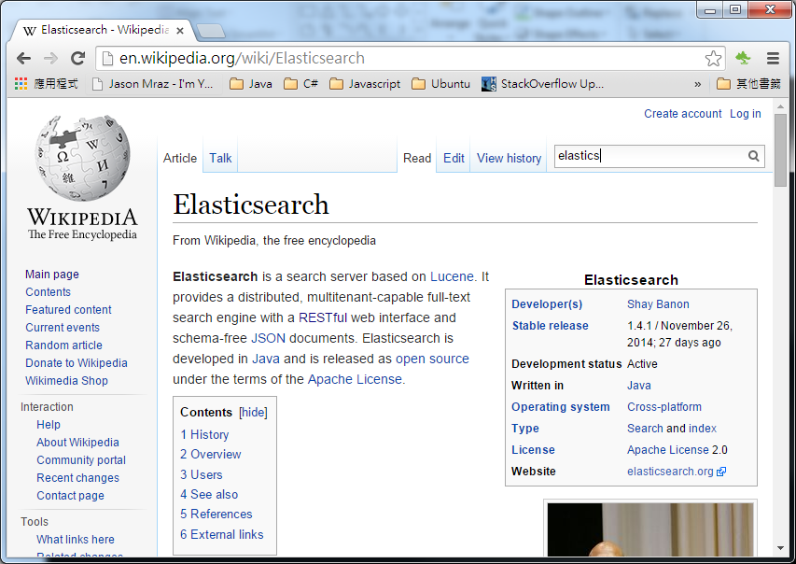
Who’s using elasticsearch?
Wikipedia
Elasticsearch’s reference manual and contribution documentation promised an easy start and pleasant time getting changes upstream when needed to.
Elasticsearch’s super expressive search API lets Wikimedia search any way needed and gives the company confidence that it can be expanded, including via expressive ad-hoc queries.
Elasticsearch’s index maintenance API lets Wikimedia maintain the index right from its MediaWiki extension

Slide 9


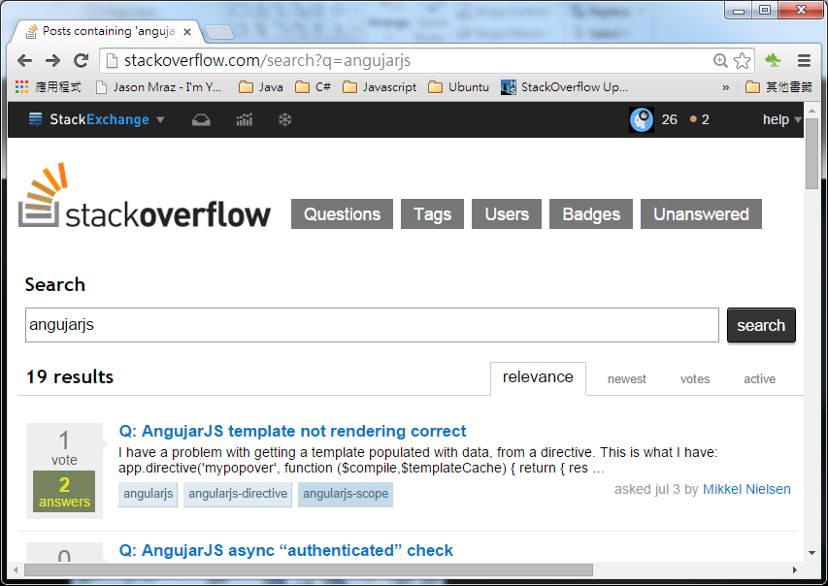
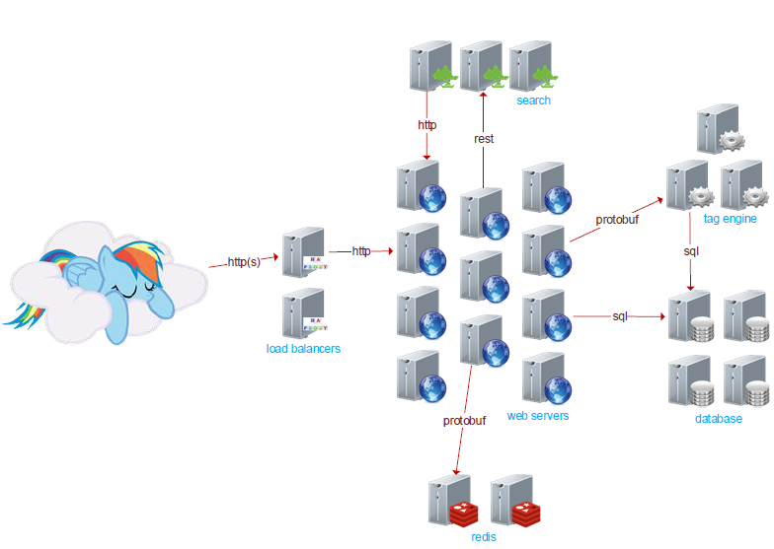
Who’s using elasticsearch?
stackoverflow
3 machines doing search with ElasticSearch

Slide 10
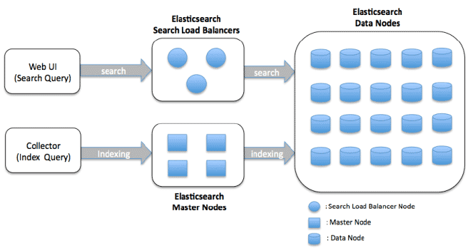
ElasticWho?
ElasticSearch is a flexible and powerful open source, distributed real-time search and analytics engine
Features:
Real time analytics
Distributed
High availability
Multi tenant architecture
Full text index
Document oriented
Schema free
RESTful API
Per-operation persistence

Slide 11
Elasticsearch Workshop

Slide 12
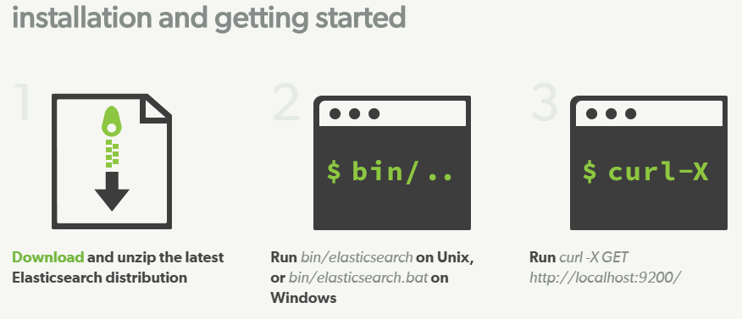
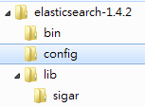
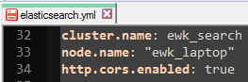
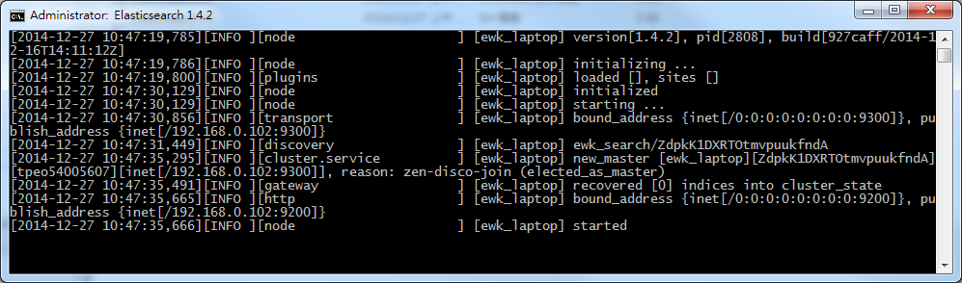
Download & Start
Download Elasticsearch (Current version: 1.4.2)
http://www.elasticsearch.com/downloads
Unzip & Modify “elasticsearch.yml”
“cluster.name: {your_searchcluster_name}”
“node.name: {your_cluster_node_name}”
“http.cors.enabled: true”
Use command console to run:
“bin/elasticsearch” on *nix
“bin/elasticsearch.bat” on Windows
1
2
3

Slide 13
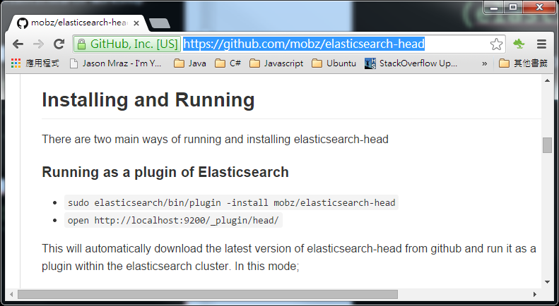
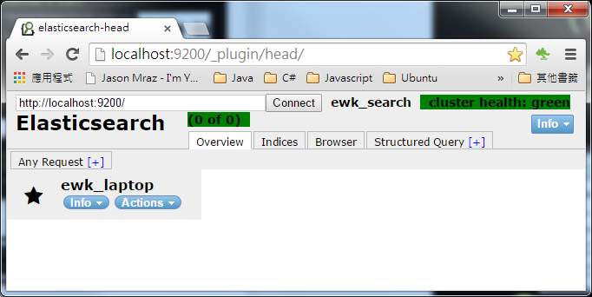
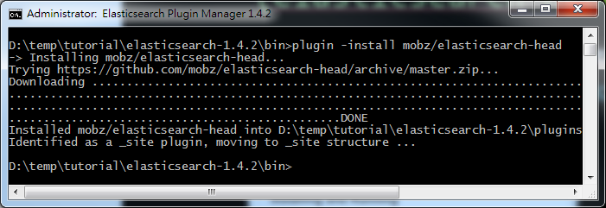
Install Elasticsearch Plugins (elasticsearch-head)
A web front end for an Elasticsearch cluster
https://github.com/mobz/elasticsearch-head
Restart elasticsearch and key in below url in browser:
http://localhost:9200/_plugin/head/
2
You need to have internet access, otherwise it would fail!!
1

Slide 14
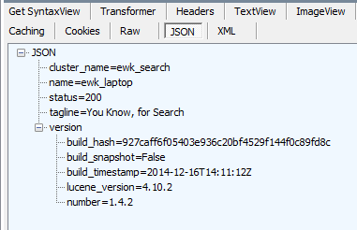
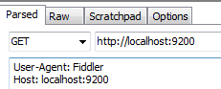
RESTful interface
Elasticsearch default use port “9200” for Http Restful interface
Let’s check if Elasticsearch is alive!!

Slide 15
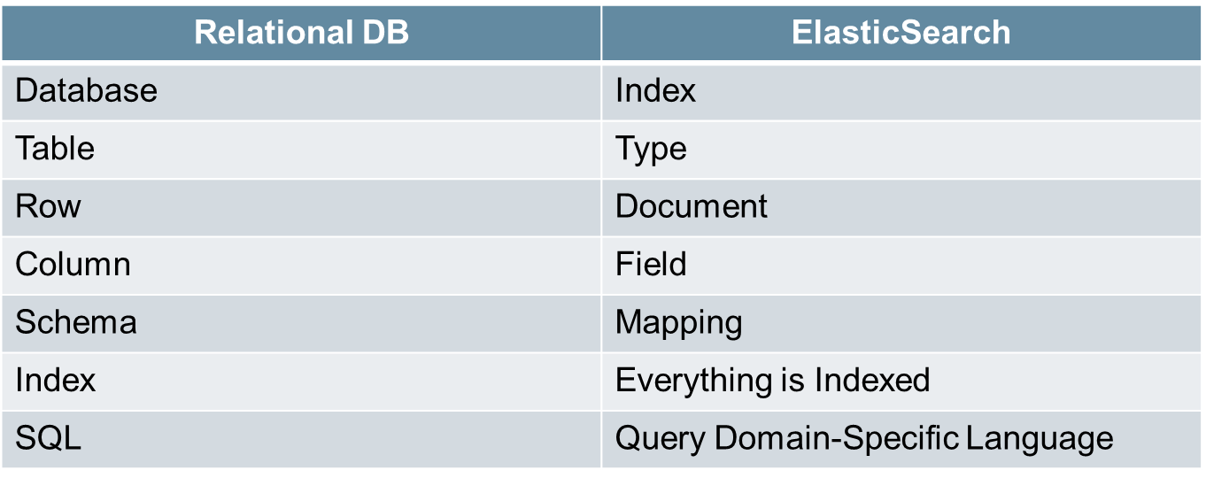
Elasticsearch TERMs

Slide 16

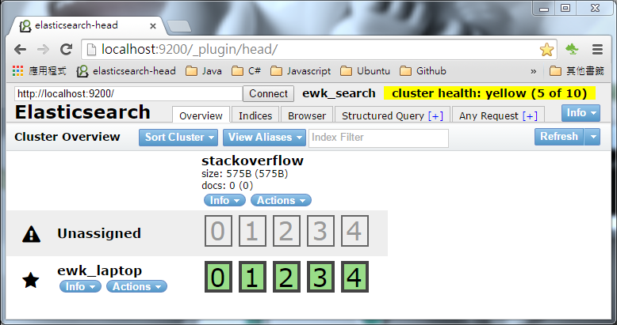
Create Index
Elasticsearch “Index” is similar like “Table” in relational DB
For example, create a index named “stackoverflow”
Default setting in Elasticsearch:
Each “Index” will split to 5 shards and has 1 replication

Slide 17
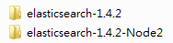
Create Another Elasticsearch Node
Copy “elasticsearch-1.4.2” folder to “elasticsearch-1.4.2-Node2”
Modify “elasticsearch-1.4.2-Node2/config/elasticsearch.yml”
“cluster.name: {your_searchcluster_name}”
“node.name: {your_cluster_node_name-Node2}”
“http.cors.enabled: true”
“transport.tcp.port: 9301”
“http.port: 9201”
If we set different Elasticsearch Node on the sameMachine, then we need to assisgn different communication ports.

Slide 18
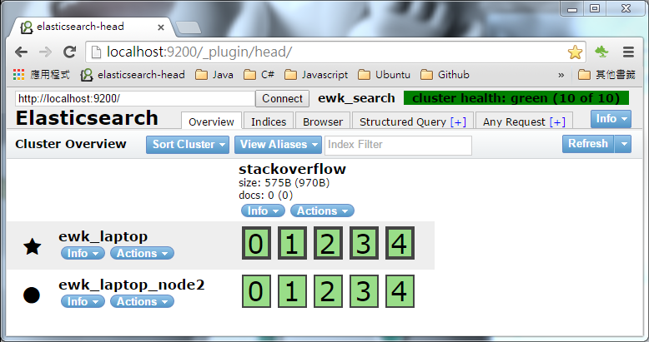
Start All Elasticsearch Nodes
Use command console to start two Elasticsearch Nodes
Now we a Elasticsearch Cluster!
So so so easy~!

Slide 19
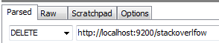
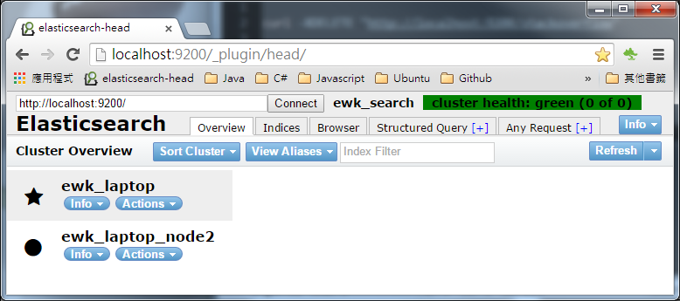
Delete Index
The Index is deleted!!

Slide 20
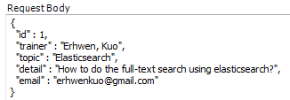
Index a “Document” under a specific “Type”
“Document.Id” is the unique Id to identify each document
“Type” is similar to “Table” in RelationDB
The content of a “Document”

Slide 21
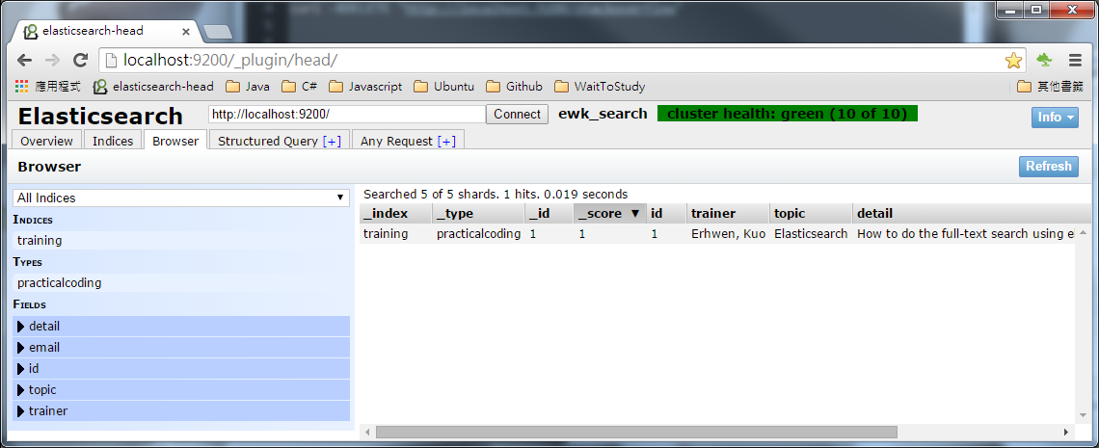
Index a “Document”
Unber “Browser” tab, we can search document

Slide 22
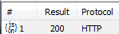
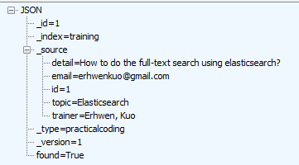
Get a “Document”
“Document.Id” is the unique Id to identify each document
“Type” is similar to “Table” in RelationDB
The content of a “Document” return by Elasticsearch

Slide 23
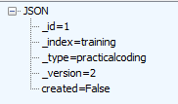
Update a “Document”
“Document.Id” is the unique Id to identify each document
“Type” is similar to “Table” in RelationDB
The “version no.” of document is incremental if it got updated!!

Slide 24
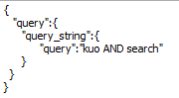
Searching “Document”
Control Searching Scope base on URL
http://www.elasticsearch.org/guide/en/elasticsearch/reference/current/query-dsl.html
Elasticsearch has very rich Search/Query DSL for document searching. Check below URL for details:
http://www.elasticsearch.org/guide/en/elasticsearch/reference/current/query-dsl.html

Slide 25
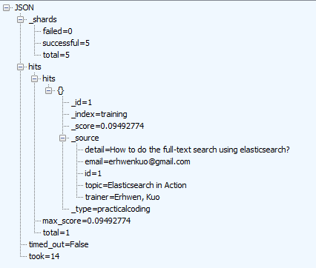
Searching Result
The documents which hits the searching query will be located under “hits/hits”
How long it takes to calculate the result (in milli-seconds)

Slide 26
Delete a “Document”
“Document.Id” is the unique Id to identify each document
“Type” is similar to “Table” in RelationDB

Slide 27

Elasticsearch in action using Stackoverflow Datadump

Slide 28
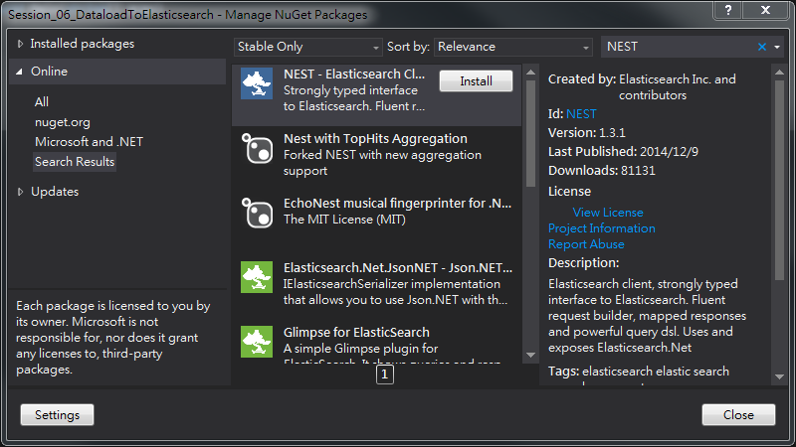
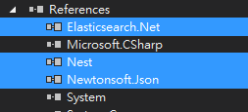
Environment Setup – Elasticsearch C# Client
Use NuGet to search “StackExchange.Redis” (C# redis client)
Click “Install”

Slide 29
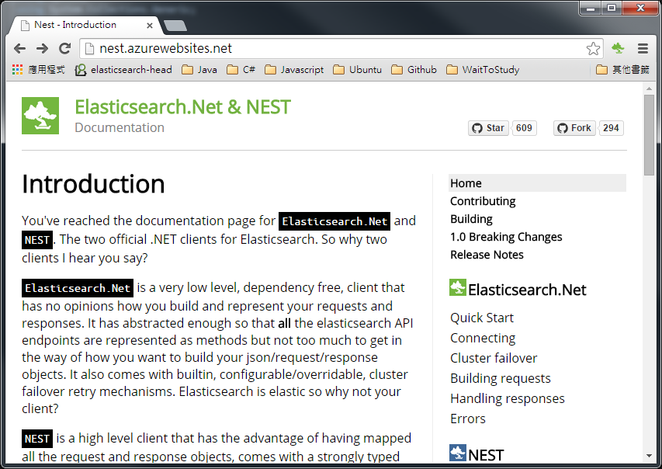
NEST (Elasticsearch C# client)
NEST provides very friendly C# interfaces to interact with Elasticseach, also there are many sample codes in its web site
http://nest.azurewebsites.net/

Slide 30
Stackoverflow Datadump
Stackoverflow periodically dump their data for public study use
https://archive.org/details/stackexchange
For demonstration purpose, we pick a smaller dataset
apple.stackexchange.com.7z (73.7MB)
Badges.xml
Commenets.xml
PostHistory.xml
PostLinks.xml
Posts.xml (116,071 records)
Tags.xml
Users.xml
Votes.xml

Slide 31
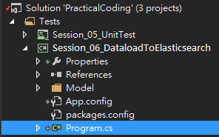
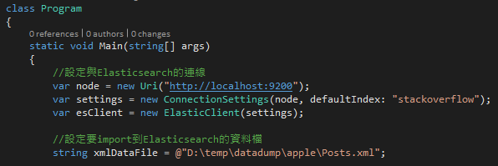
Session_06_DataloadToElasticsearch
A new C# “Console” program project (“Session_06_DataloadToElasticsearch”) is created to parsing data dump xml file and import into Elasticsarch
Open “Program.cs” file and modify below:
Change the Uri of your elasticsearch cluster IP & port
This is the “Index” need to be created before running this program
Change the xmlDataFile path to the location of data dump file

Slide 32
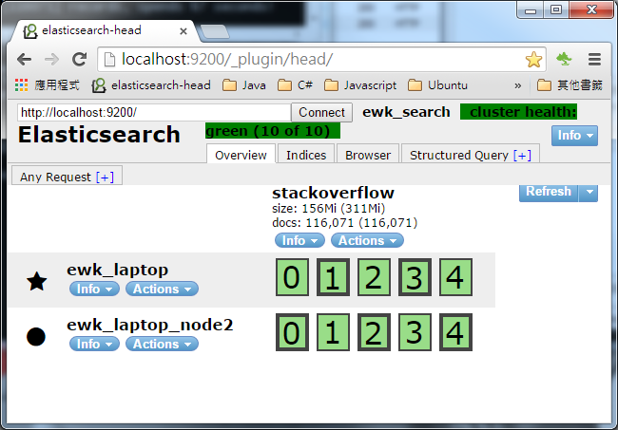
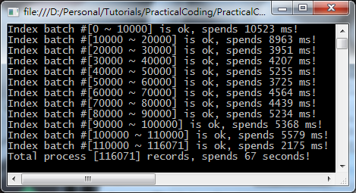
Execute “Session_06_DataloadToElasticsearch” ”Program.cs”
1
It spends 67 seconds to index 116071 records
3
2

Slide 33
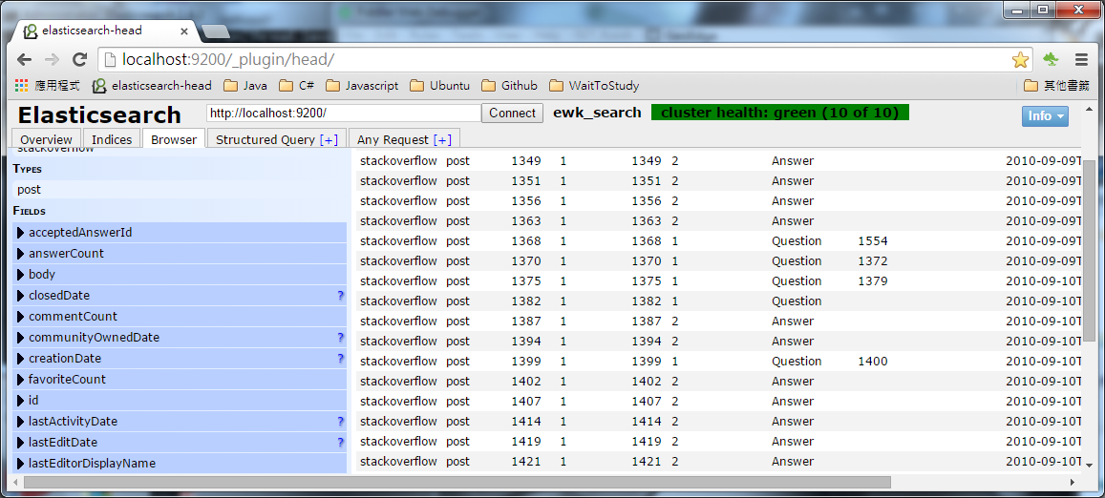
Exploer Data via “Brower”

Slide 34
The _search endpoing
To search with ElasticSearch we use the “_search” endpoint
We make http requests to an URL following this pattern: (“index” & “type” are both optional)
<index>/<type>/_search
For example:
Search across all indexes and all types
http://localhost:9200/_search
Search across all types in the “stackoverflow” index
http://localhost:9200/stackoverflow/_search
Search explicitly for documents of type “post” within the “stackoverflow” index
http://localhost:9200/stackoverflow/post/_search

Slide 35
Search request body and ElasticSearch's query DSL
elasticsearch provides a full Query DSL based on JSON to define queries
http://www.elasticsearch.org/guide/en/elasticsearch/reference/current/query-dsl.html
Think of it like ElasticSearch's equivalent of SQL for a relational database
Query DSL contains:
Query
Filter
*** Filter are very handy since they perform an order of magnitude better than plain query since no scoring is performed and they are automatically cached

Slide 36
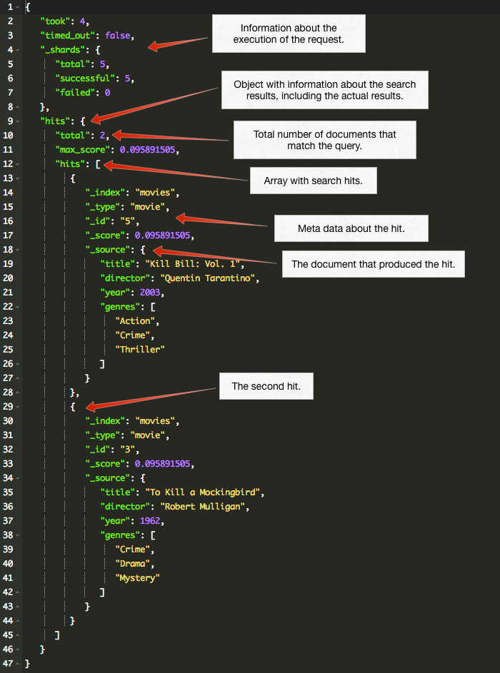
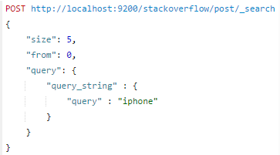
Basic free text search
The query DSL features a long list of different types of queries that we can use
For "ordinary" free text search we'll most likely want to use one called "query string query".

Slide 37
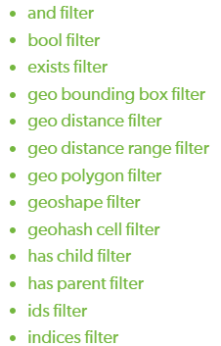
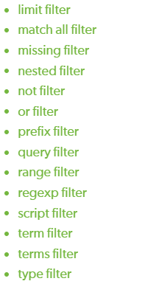
Elasticsearch Query DSL - Filter
As a general rule, filters should be used instead of queryies:
for binary yes/no searches
for queries on exact values
Filters can be caching. Caching the result of a filter does not require a lot of memory, and will cause other queries executing against the same filter (same parameters) to be blazingly fast

Slide 38
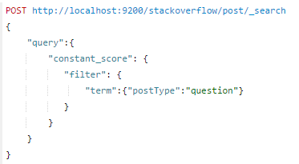
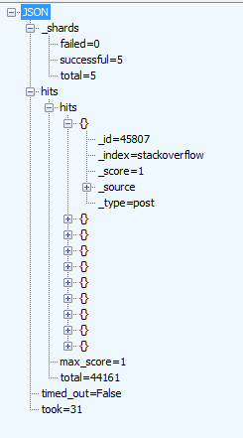
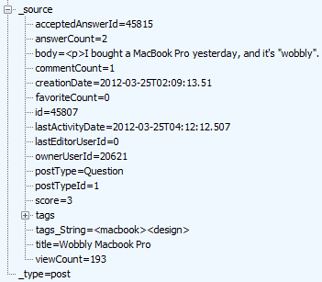
Filter without Query

Slide 39

Developing Angularjs with Elasticsearch

Slide 40
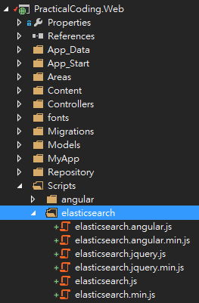
Elasticsearch Javascript Client Library
Go to Elasticsearch web site & get javascript client
elasticsearch-js-2.4.3.zip
http://www.elasticsearch.org/guide/en/elasticsearch/client/javascript-api/current/browser-builds.html
Unzip and import to “PracticalCoding.Web” Project under “/Scripts/elasticsearch” folder
Notes:
Hightchart是位處於北歐挪威的一家小公司Highsoft AS所開發.
在2014年, 這家公司只有14名員工, 其中8位是工程師.
下載Hightcharts, 再把它的的javascripts全部都include到專案中

Slide 41
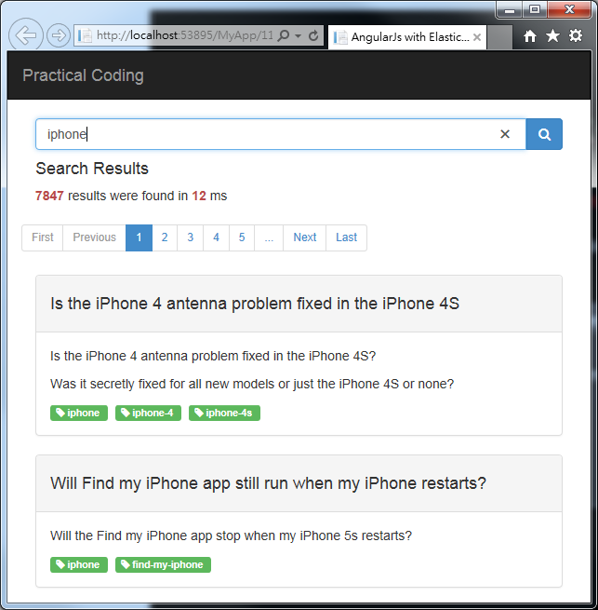
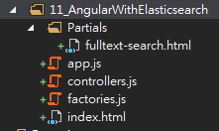
Setup Fulltext-Search SPA Skelton
Create “11_AngularWithElasticsearch” folder under “MyApp”
Create files and subfolder according to the diagram

Slide 42
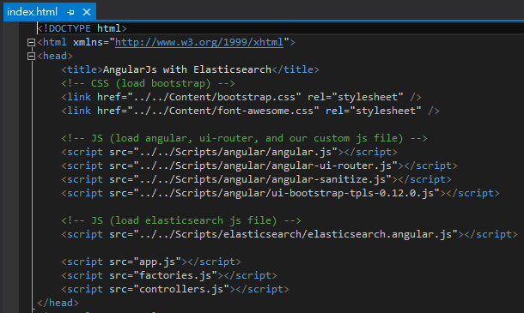
index.html
“angular-sanitize.js” is used to handle “html content” showing on UI
“ui-bootstrap-tpls-.js” is used to show & control “pagination”
“elasticsearch.angular.js” is used to connect Elasticsearch & submit query command

Slide 43
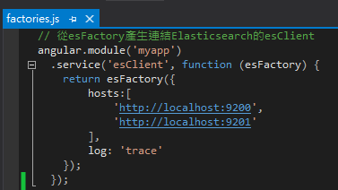
factories.js
use “esFactory” to connect elasticsearch clusters
define our elasticsearch cluster host IPs

Slide 44

app.js
define our routing, UI template & controller

Slide 45

fulltext-search.html (1)

Slide 46

fulltext-search.html (2)

Slide 47
fulltext-search.html (2)

Slide 48


controllers.js

Slide 49


Fulltext-Search Demo
Demo Page
Select “11_AngularWithElasticsearch/index.html” and Hit “F5” to run

Slide 50
Highchart , AngularJS ,Web API2 , SignalR2, Redis + Elasticsearch Integration

Slide 51
Integration with Entity Framework
Copy “10_IntegrationWithRedis ” to “12_IntegrationWithElasticsearch ”

Slide 52




Create New ElasticDashboardRepo.cs
Control Unique ID generation and management via Redis

Slide 53


Initial Chartdatas (Global.asax.cs)

Slide 54

Switch “RedisDashboardRepo” to “ElasticsearchDashboardRepo”
Copy “RedisDashboardController.cs” to “ElasticsearchDashboardController.cs”
Switch our Repository from “Redis” to “Elasticsearch”

Slide 55


Modify Our Angular “ChartDataFactory”
Switch angular $http communication end point to our new WebAPI url
Before
After

Slide 56



Integration with Elasticsearch
Demo
Select “12_IntegrationWithElasticsearch/index.html” and Hit “F5” to run
Open Multi-Browser to see charts reflect changes whenever C/U/D operations occurred

